Slide 1
Polynomial Multiplication
Naive – 30 seconds
Karatsuba – 3 minutes
DFT – 2 minutes
FFT – 5 minutes
Implementation – 1 minute
Reflections – 2 minutes

Slide 2
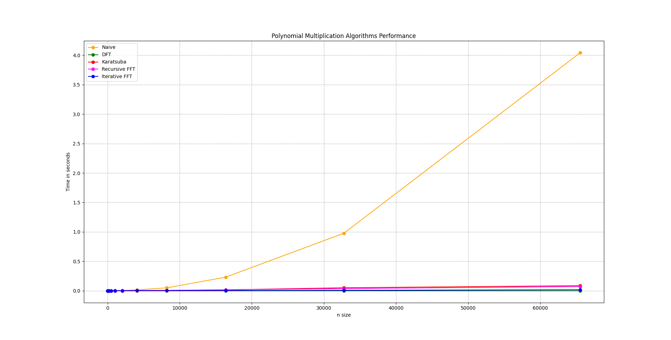
Naive
Base case

Slide 3
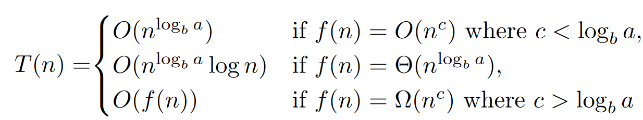
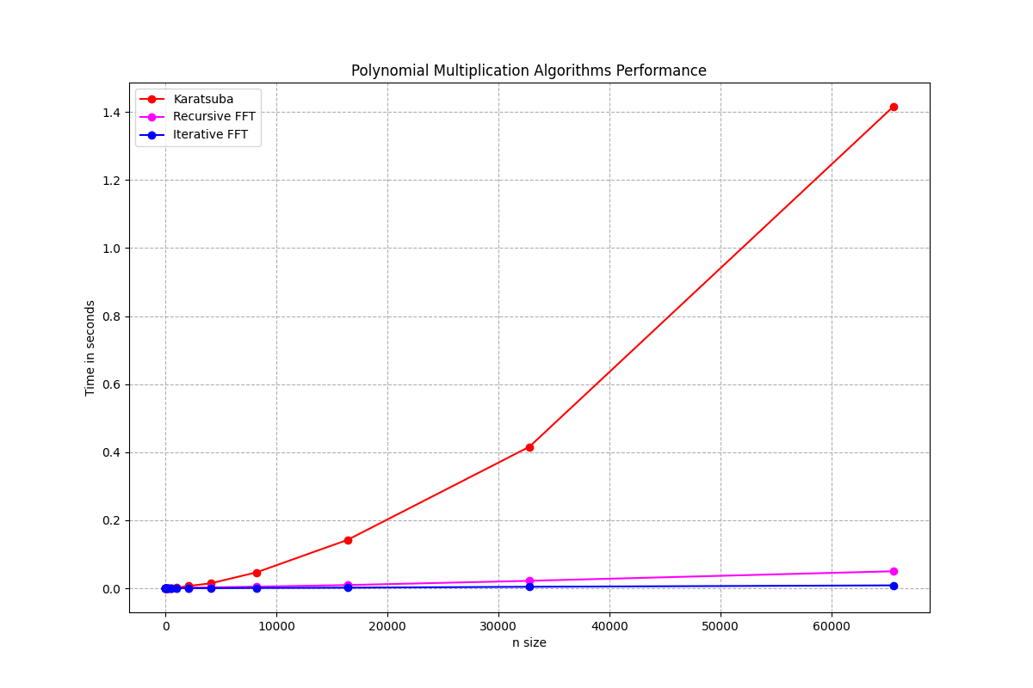
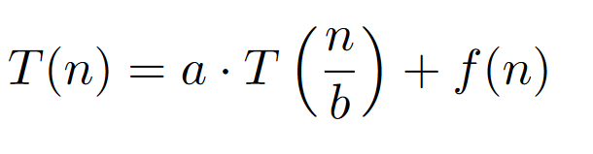
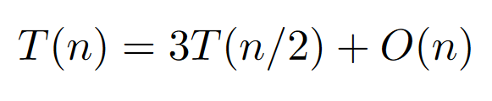
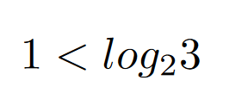
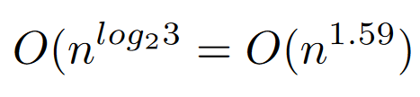
Karatsuba’s Algorithm
Divide and Conquer Algorithm
Splits the polynomial into low, mid and high
Halves the problem size each recursive call
Performs 3 recursive calls per Iteration

Slide 4

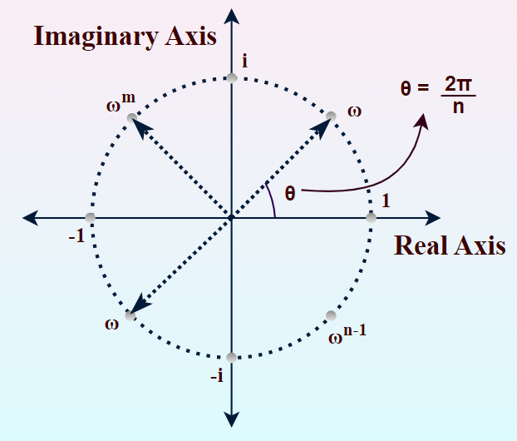
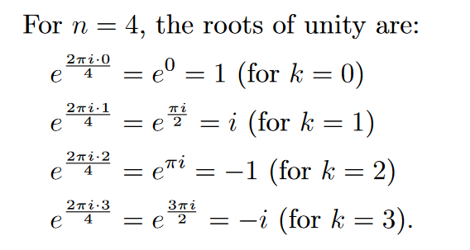
Euler’s Formula
Real numbers on X axis
Imaginary numbers on Y axis
Think of roots of Unity as stops on the circle

Slide 5
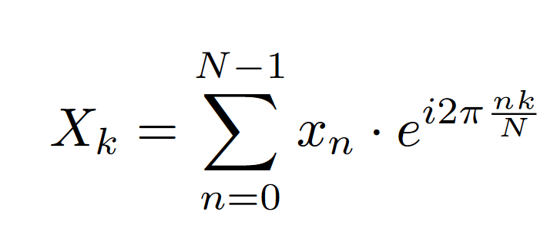
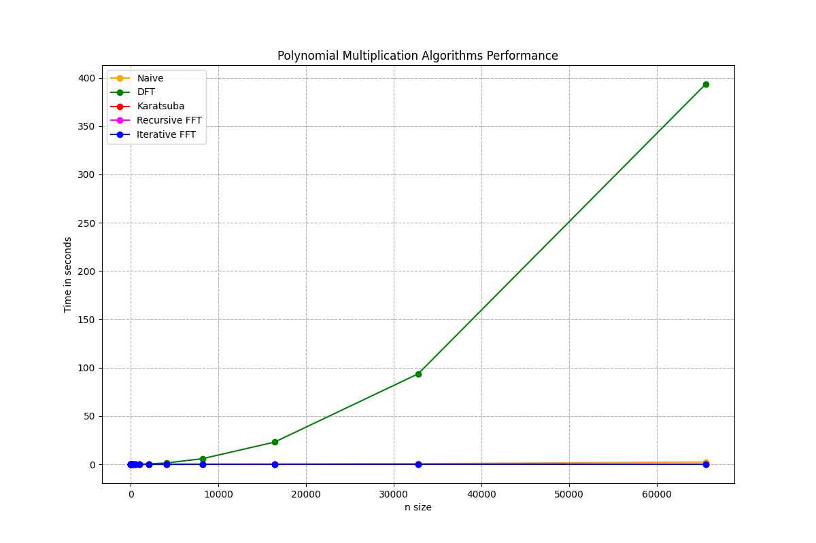
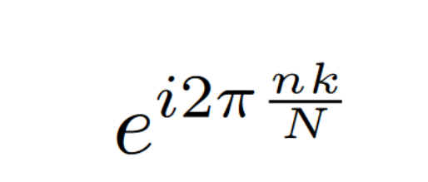
DFT
Converts From Time Domain to Frequency Domain
IDFT inverses that
Based on Euler’s Formula
Twiddle Factor

Slide 6
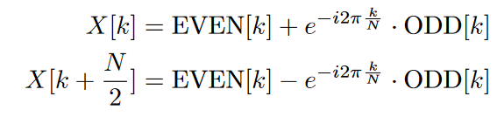
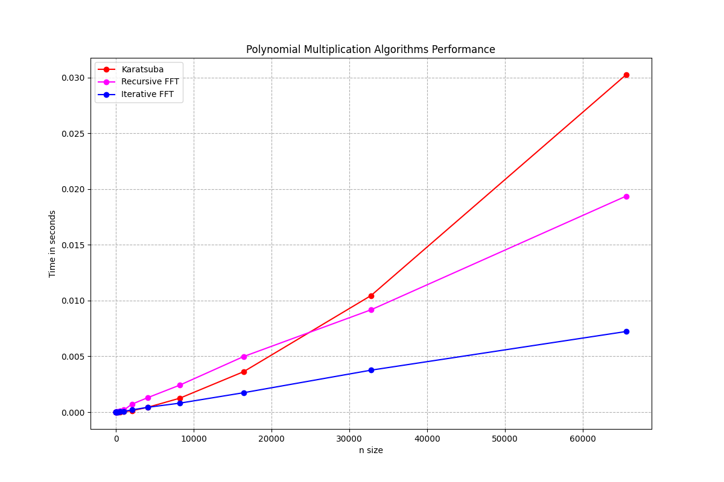

FFT
Uses symmetries and Divide and Conquer to improve DFT’s Runtime
Iterative version utilizes Butterfly diagram to improve runtime
Only works on

Slide 7
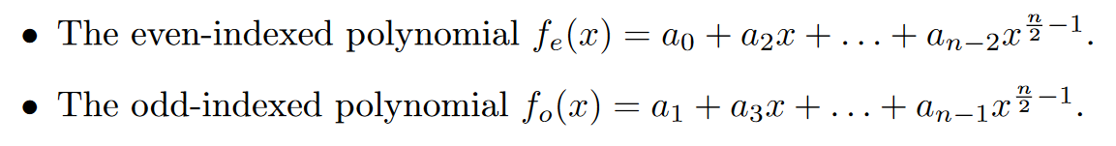

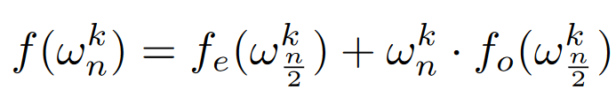
FFT Proof of Correctness
DFT
Base case N = 1, it simply returns the input
Inductive step:
Divide the Polynomial :
Process is repeated until N=1
Implement Twiddle factor:
Conquer by combining the results using the Twiddle Factor:

Slide 8
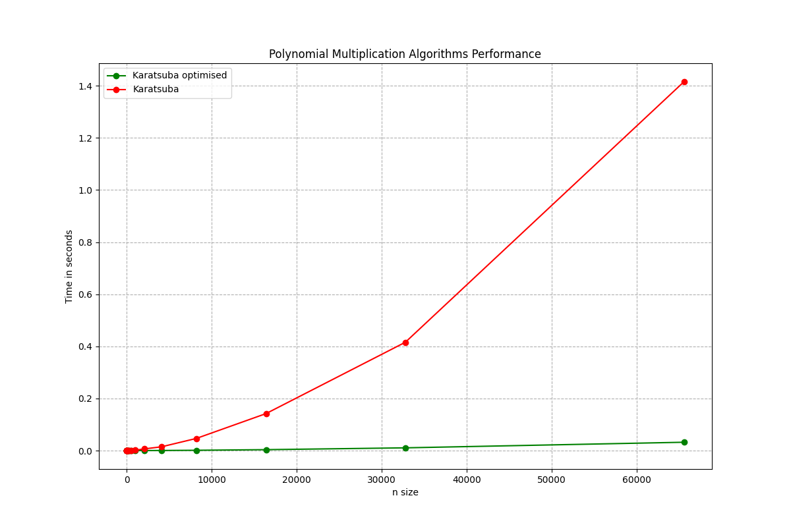
Implementation
Karatsuba Optimization
Optimization Priority
Test Driven Development

Slide 9
Reflections
Rewrite DFT section
Larger Test
Code Cleanup
Deeper runtime Analysis
Cache and memory optimisation
Toom-Cook Implementation

